Slide 1
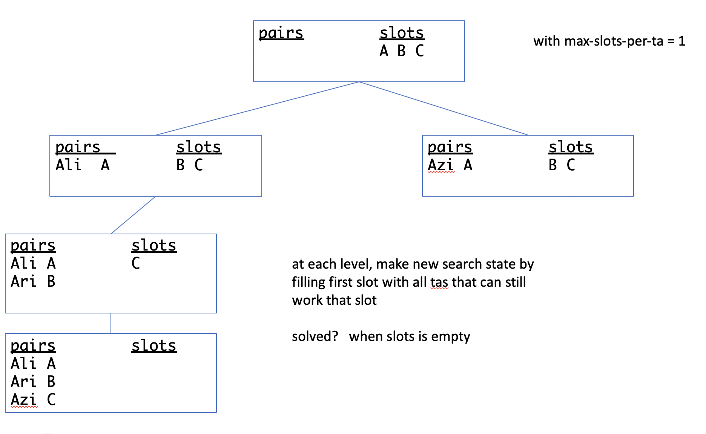
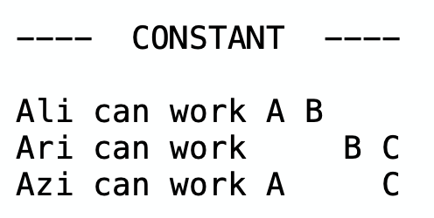
Pset 9

Slide 2
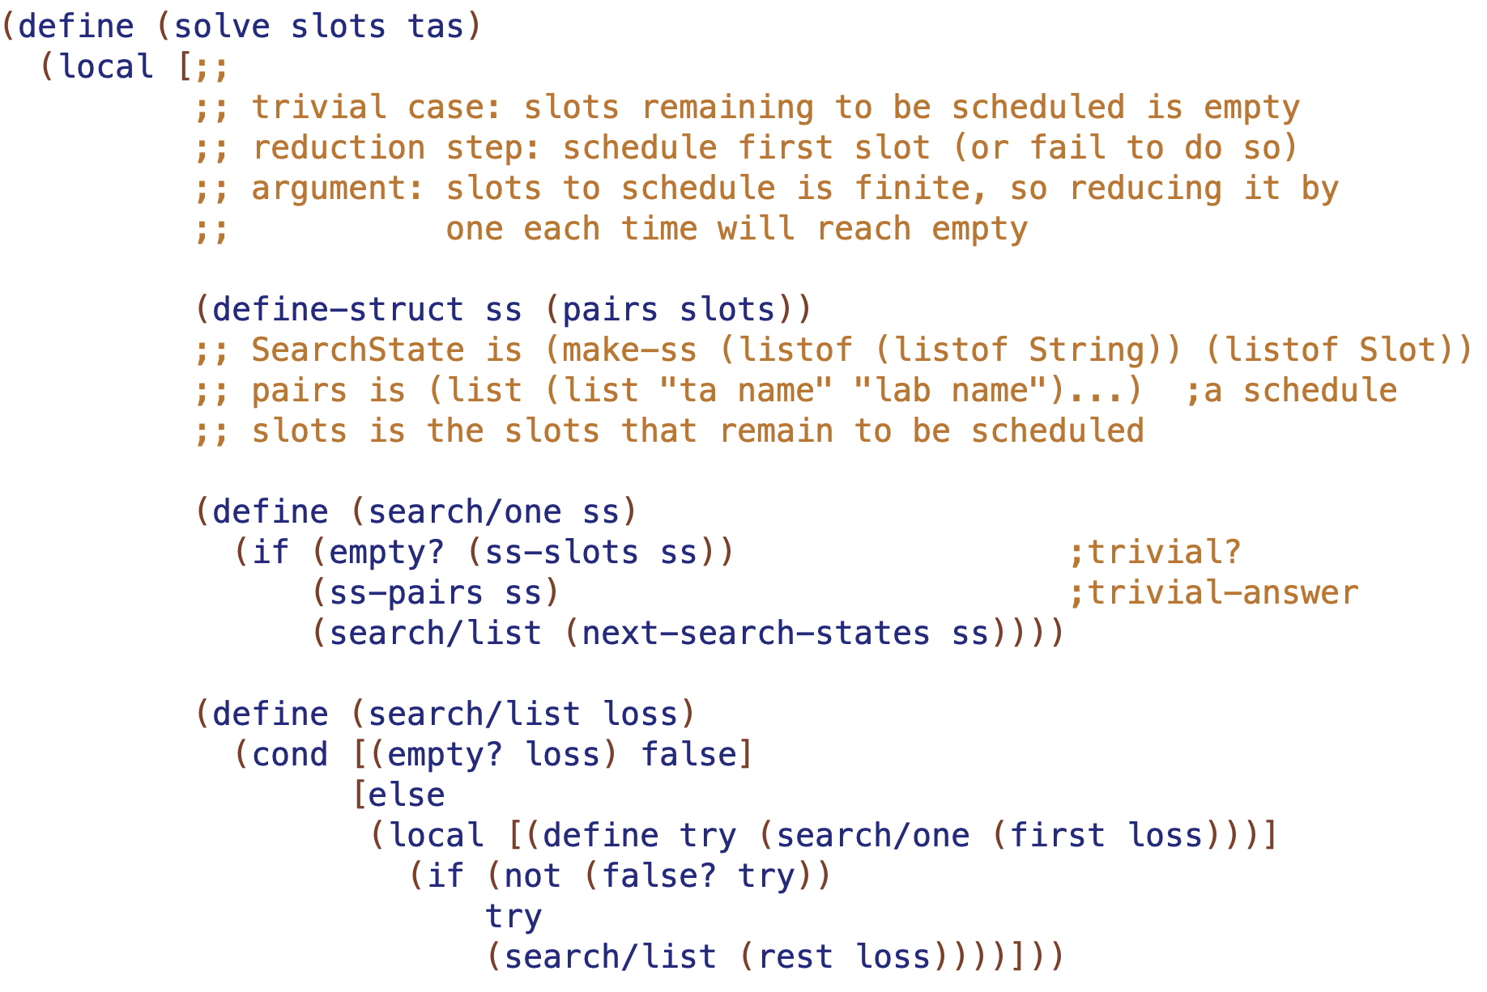

Slide 3
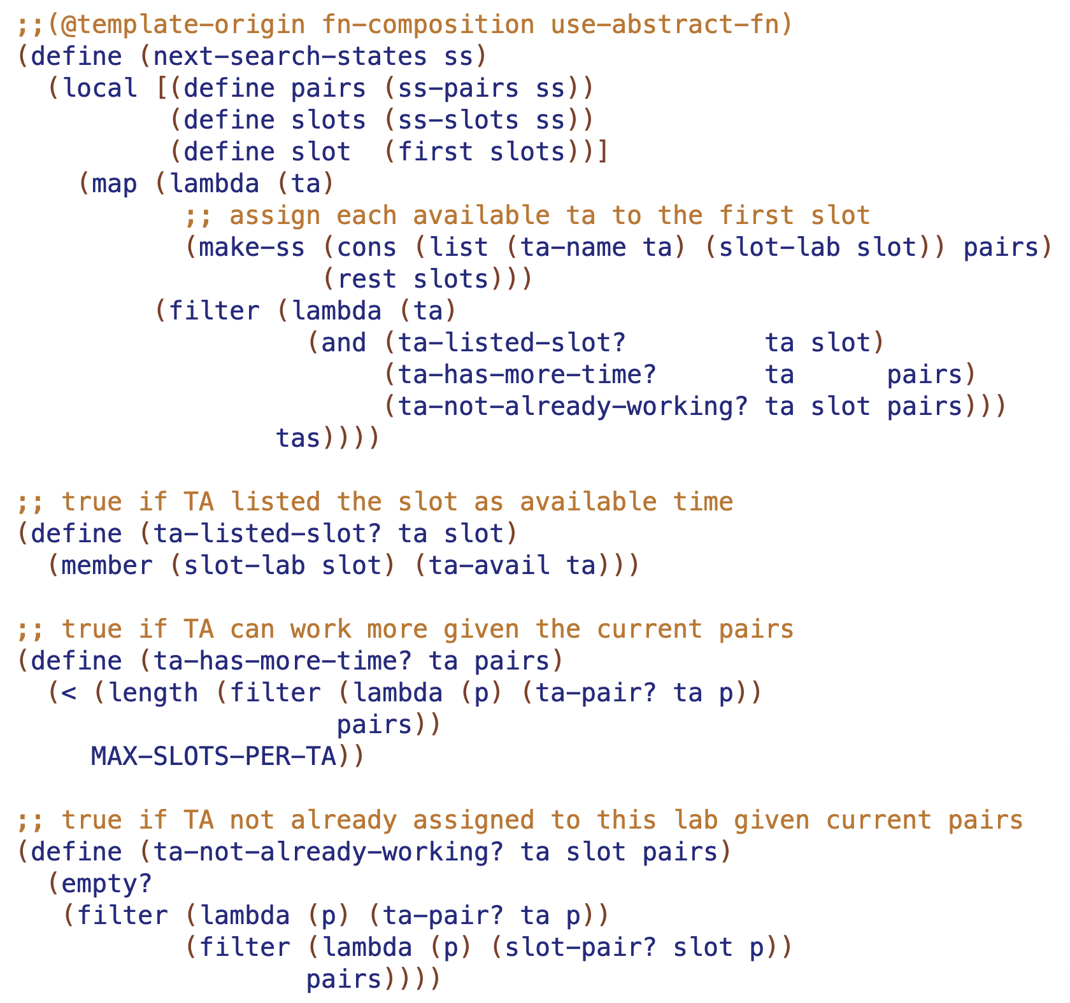

Slide 4
Roadmap
These five lectures
forms of data: trees and graphs
recursion: structural non-tail and tail and generative
accumulators
path in data: previous, upper, lower, pnum, path
rsf (result so far)
visited in tail recursion: vnum, count, leaves, visited
worklist
tandem worklist l18 l19 l20 l21 l22

Slide 5
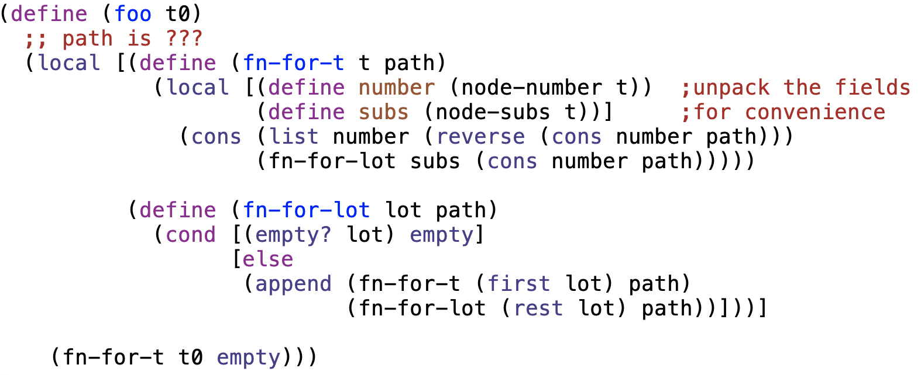
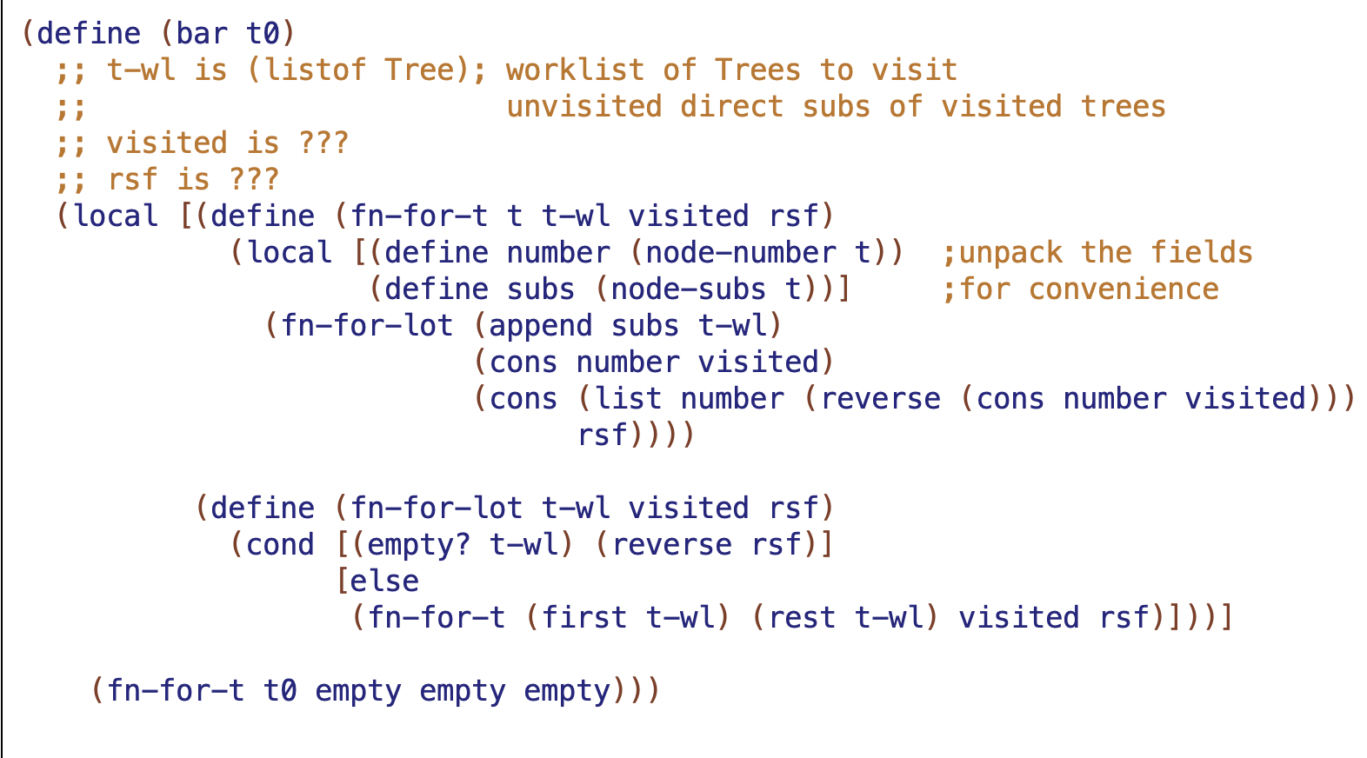
Here are two function definitions, without purpose statements, examples, template origins, or accumulator types and invariants.
For each function, work out the progression of accumulator values as the function goes through the entire tree

Slide 7
foo
TOP1 - 10
M1 - 20
M2 - 40
L1 -30
L2 - 50
L3 - 60

Slide 8
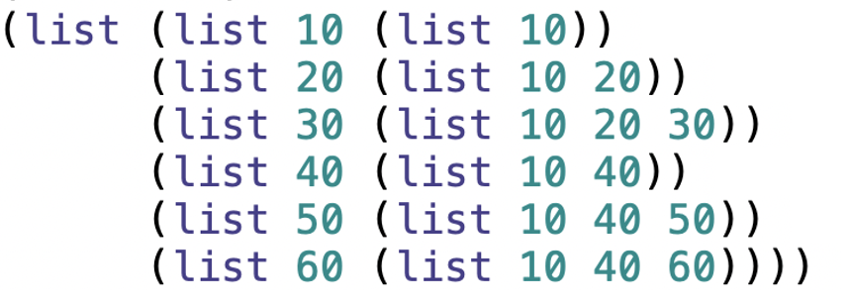
foo produce-path-at-nodes
()
TOP1 - 10
(10 )
(10 )
(10)
M1 - 20
M2 - 40
(20 10)
(40 10)
(20 10)
(40 10)
(40 10)
L1 -30
L2 - 50
L3 - 60
(30 20 10)
(50 40 10)
(60 40 10)

Slide 10
bar
TOP1 - 10
M1 - 20
M2 - 40
L1 -30
L2 - 50
L3 - 60

Slide 11
bar produce-visited-at-nodes
()
TOP1 - 10
(10 )
(10 )
(30 20 10)
M1 - 20
M2 - 40
(20 10)
(40 30 20 10)
(30 20 10)
(50 40 30 20 10)
(20 10)
L2 - 50
L1 -30
(40 30 20 10)
L3 - 60
(60 50 40 30 20 10)
(50 40 30 20 10)

Slide 12
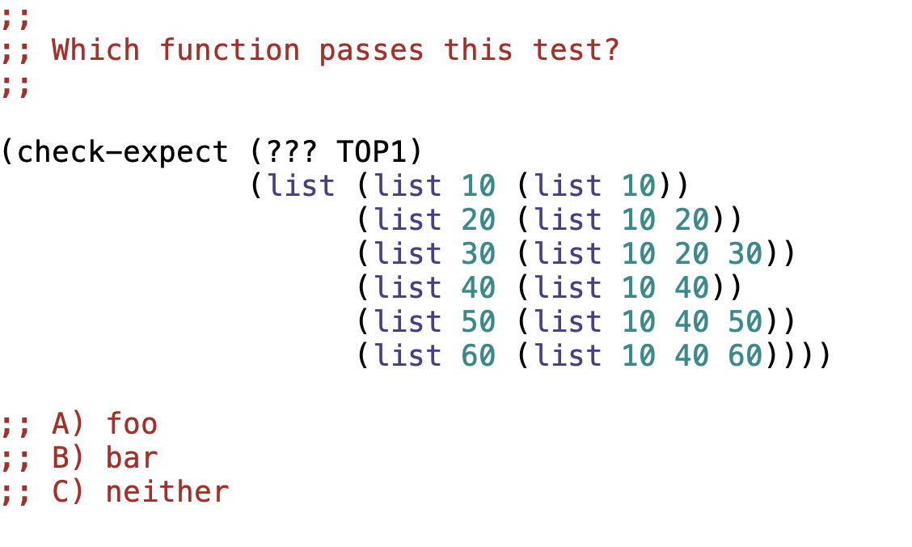
TOP1 - 10
M1 - 20
M2 - 40
L1 -30
L2 - 50
L3 - 60

Slide 13
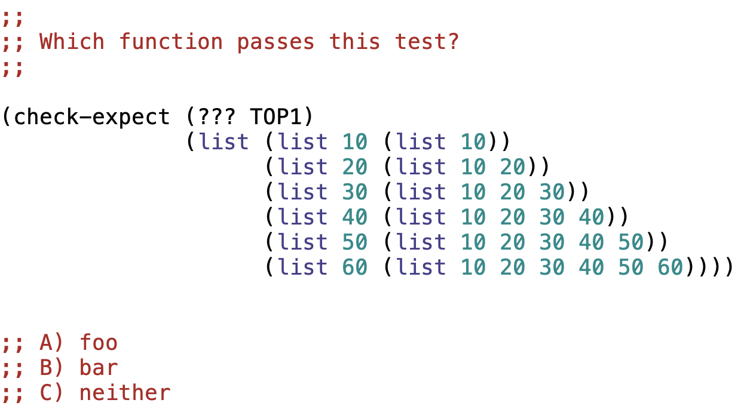
TOP1 - 10
M1 - 20
M2 - 40
L1 -30
L2 - 50
L3 - 60

Slide 14
foo produce-path-at-nodes
()
TOP1 - 10
(10 )
(10 )
(10)
M1 - 20
M2 - 40
(20 10)
(40 10)
(20 10)
(40 10)
(40 10)
L1 -30
L2 - 50
L3 - 60
(30 20 10)
(50 40 10)
(60 40 10)

Slide 15
bar produce-visited-at-nodes
()
TOP1 - 10
(10 )
(10 )
(30 20 10)
M1 - 20
M2 - 40
(20 10)
(40 30 20 10)
(30 20 10)
(50 40 30 20 10)
(20 10)
L2 - 50
L1 -30
(40 30 20 10)
L3 - 60
(60 50 40 30 20 10)
(50 40 30 20 10)

Slide 16
What’s in the past depends on the recursion
tail recursion means current call can have all preceding calls
in a tree
ordinary recursion can carry context of what is above current call
but tail recursion is required to carry context of what is above and to the LEFT

Slide 17
t-wl at fn-for-t and fn-for-lot
(list)
TOP1 - 10
1
(list M1 M2)
2
(list M2)
M1 - 20
M2 - 40
(list)
3
7
(list L1 M2)
(list L2 L3)
4
8
6
(list M2)
(list L3)
(list)
L1 -30
L2 - 50
L3 - 60
5
9
10
11
(list M2)
(list L3)
(list)

Slide 18
Module 11 - Graphs
3 examples
lecture – 4 way maze
lab – city map
problem set – secret castle

Slide 19

Tree of x,y positions moving through this maze
0, 0
1, 0
0, 1
1, 1
0, 2
2, 1
1, 2
At each step it is only possible to move right (x+1) or down (y+1). But sometimes those may be invalid because they run into a wall or off the edge of the maze.
Do not assume each position can have only one valid next position. In general it is an arbitrary-arity tree.
…
This maze is solveable, so will eventually reach 4, 4. Yay!

Slide 20
(define M4
(list O O O O O
O W W W O
O W O O O
O W O W W
W W O O O))
must move left
need to be able to move up down left right

Slide 21


Slide 22
(define M7
(list O O O O O O O O O O
W W O W W O W W W O
O O O W W O W O O O
O W O O W O W O W W
O W W O W W W O O O
O W W O O O W W W O
O W W O W O W O O O
O W W O O O W O W W
O O O O W W W O O O
W W W W W O O W W O))

Slide 23
(define M7
(list O O O O O O O O O O
W W O W W O W W W O
O O O W W O W O O O
O W O O W O W O W W
O W W O W W W O O O
O W W O O O W W W O
O W W O W O W O O O
O W W O O O W O W W
O O O O W W W O O O
W W W W W O O W W O))
cycle
How do we prevent going in circles forever?

Slide 24
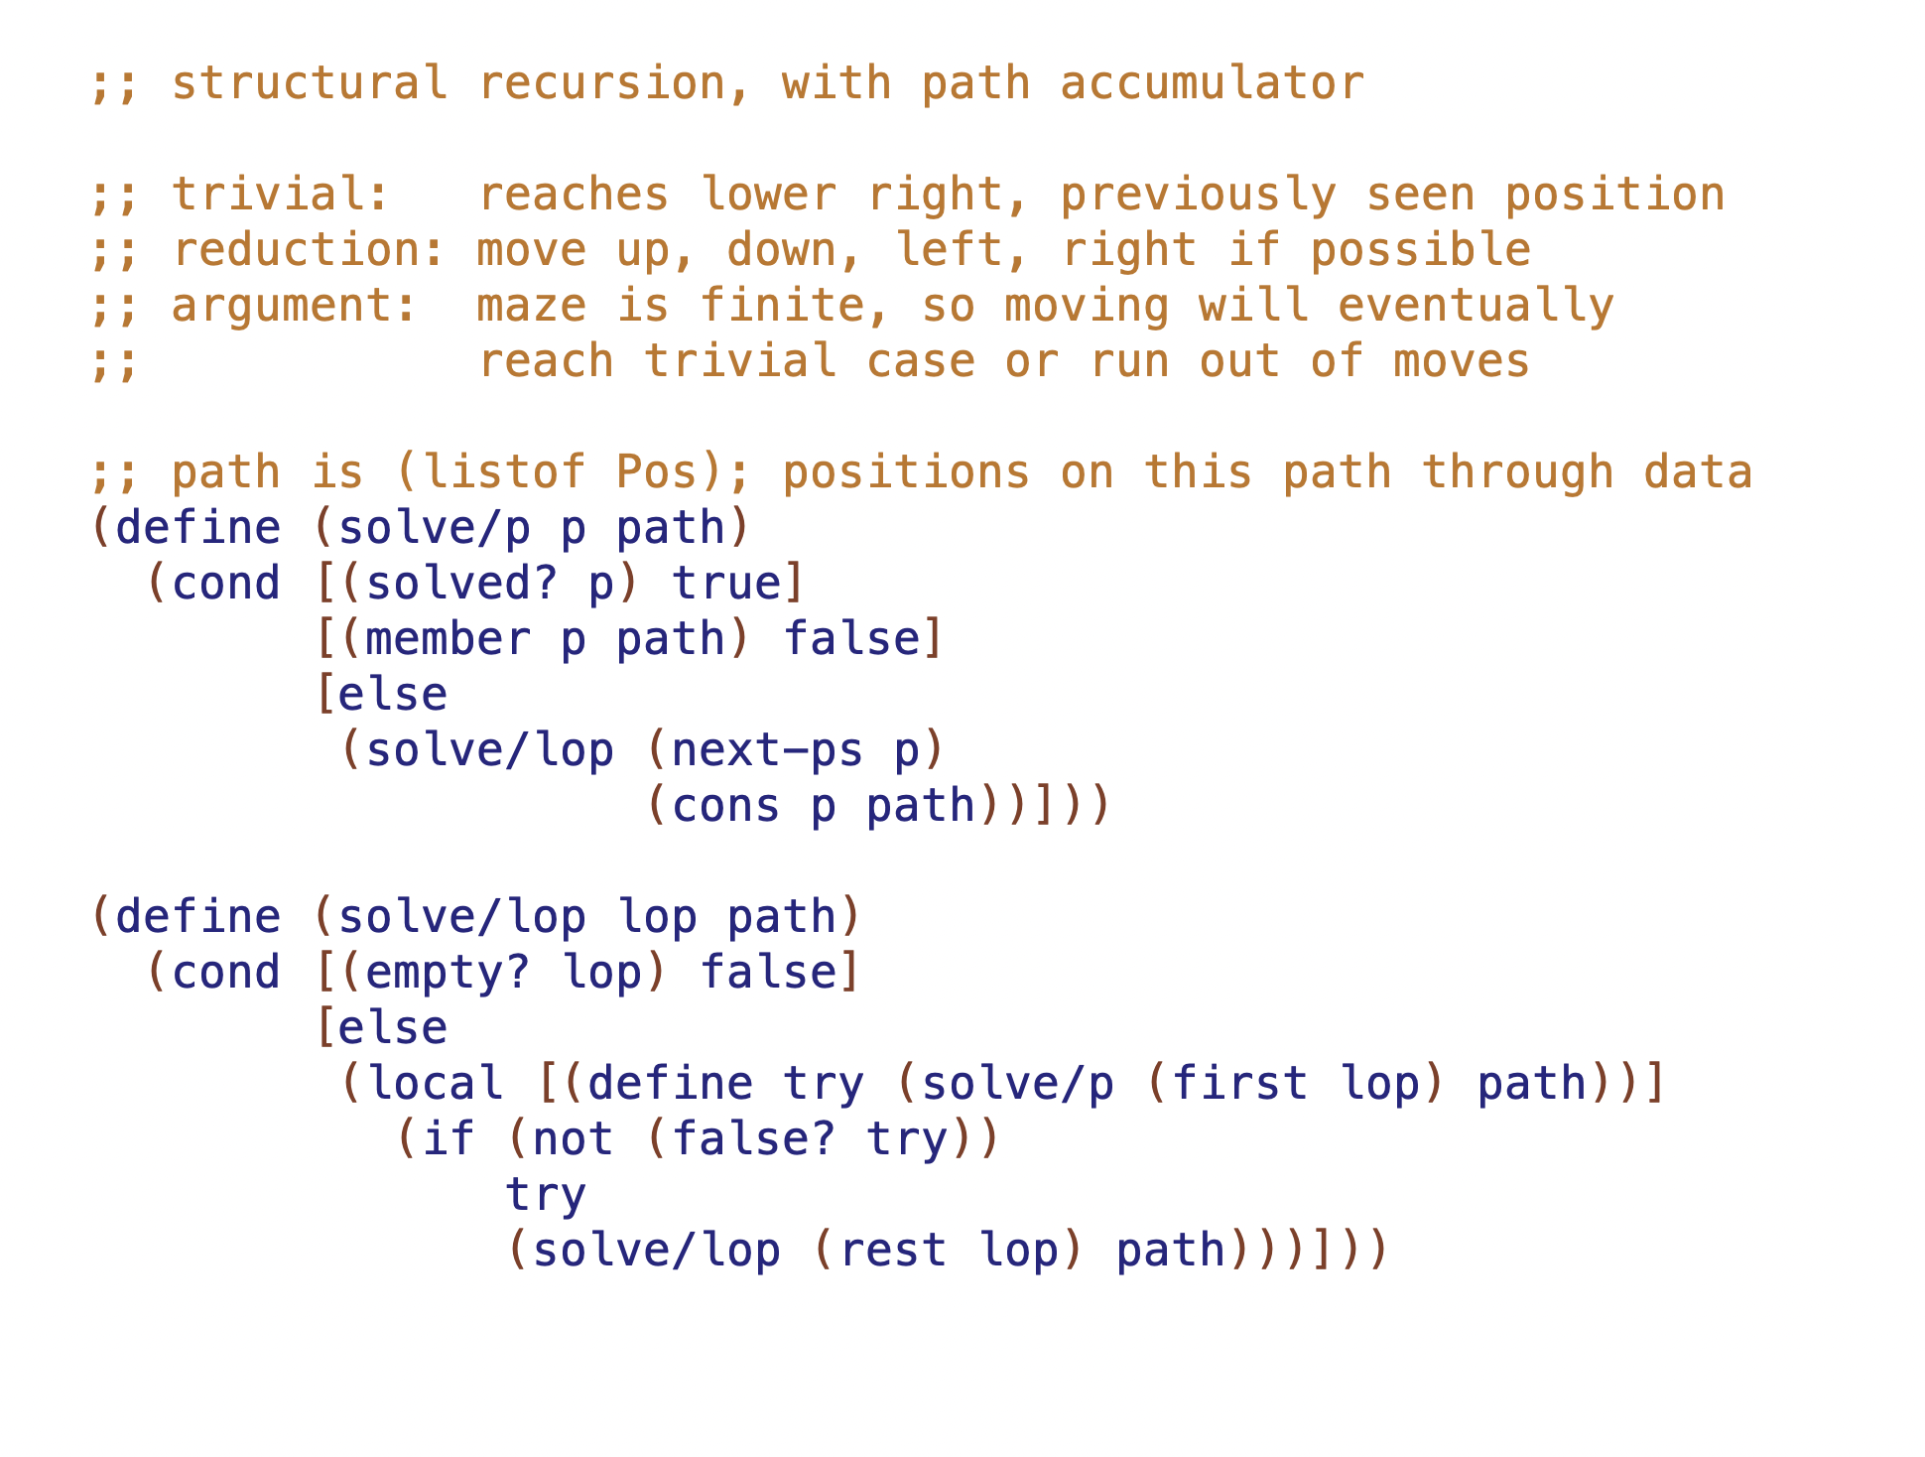

Slide 25
(define M7
(list O O O O O O O O O O
W W O W W O W W W O
O O O W W O W O O O
O W O O W O W O W W
O W W O W W W O O O
O W W O O O W W W O
O W W O W O W O O O
O W W O O O W O W W
O O O O W W W O O O
W W W W W O O W W O))
cycle
Would it also work with tail recursion and visited?

